Slide 1
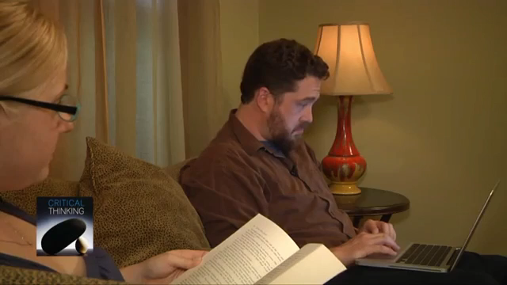
Your turn

Slide 2
Homework for next week
A short set of videos followed by questions to answer
This will be posted on Canvas by Thursday

